Slide 1

AEP: An Error–bearing Neural Network Accelerator for Energy Efficiency and Model Protection
Lei Zhao⁺, Youtao Zhang⁺, Jun Yang*
⁺Computer Science Department, University of Pittsburgh
*Electrical and Computer Engineering Department, University of Pittsburgh

Slide 2
Outline
Background
Observation
Design Overview
Design Details
Experiment Setup
Results

Slide 3
Outline
Background
Observation
Design Overview
Design Details
Experiment Setup
Results

Slide 4



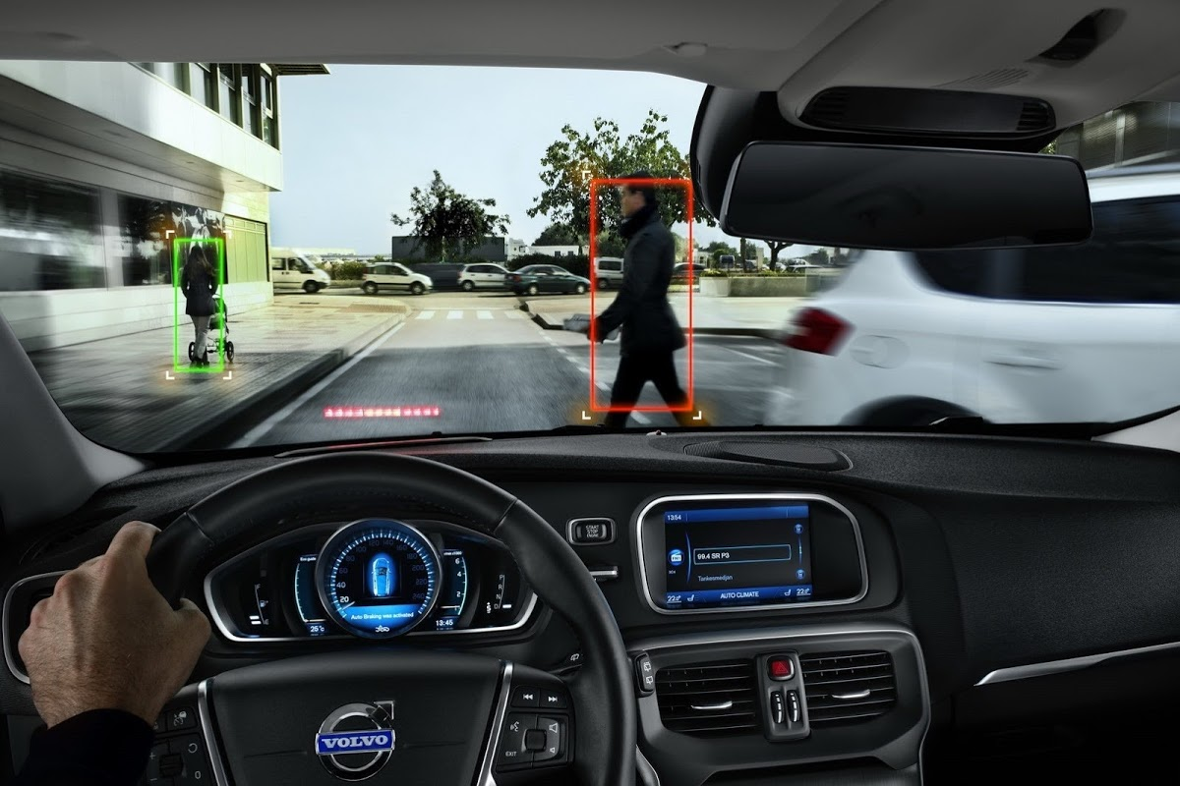
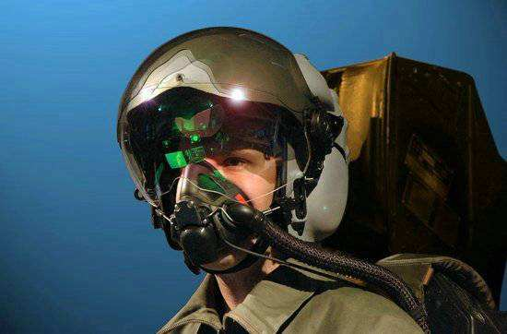
Neural Networks In Applications
Augmented reality
Security
Neural Networks
Self driving cars
Games
Military

Slide 5






Neural Networks Need To Be Protected
TRAINING DATA PRIVACY
COMPUTATION POWER
Patient privacy
Super computers
Commercial data
Cloud computing
INTELLECTUAL PROPERTY
Pretrained models
can be reused for
other related tasks
Takes weeks to
months of training
TRAINING TIME
TRANSFER LEARNING

Slide 6
Outline
Background
Observation
Design Overview
Design Details
Experiment Setup
Results

Slide 7
Observation
Gradient methods find the local minima in the error surface of deep models
The solution is not unique
Iter 0
0
1
1
0
…
0
1
0
1
1
Iter 1
0
0
1
1
…
1
1
1
0
0
Iter 2
1
0
1
1
…
0
0
0
0
1
1
Iter 3
0
0
1
0
…
1
1
multiple solutions

Slide 8
Observation
The learning procedure adapts to the error automatically
The errors force the learning to find other solutions (local minima)
Iter 0
0
1
1
0
…
0
1
0
1
1
Iter 1
0
1
1
1
…
0
1
1
0
0
1
0
Iter 2
1
1
0
1
…
0
0
0
0
1
1
Iter 3
1
1
0
0
…
0
1

Slide 9
Outline
Background
Observation
Design Overview
Design Details
Experiment Setup
Results

Slide 10





Overview
Mask Database
How to generate
device dependent
error masks
①
Server
②
Extract error masks from target device, and store them into Mask Database
Train the NN with error masks on server
The trained weights can only work on the target device
Even if the weights are stolen and deployed on the pirate device, they are useless
Target Device
weights
How to integrate
error masks into
trained weights
weights
③
How secure it is
Pirate Device

Slide 11
Outline
Background
Observation
Design Overview
Design Details
Error Masks
Error-bearing Training
Securing Error Masks at Client Side
Experiment Setup
Results

Slide 12
Generating Error Masks
charge
sharing
sense
amplification
restored
precharged
precharged
cell
bitline
cell
bitline
cell
bitline
cell
bitline
cell
bitline
tRCD
tRAS
tRP
tRCD: time to read data out
tRAS: time to restore data back into cell
tRP: time to precharge bitline for next read

Slide 13
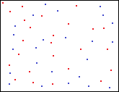
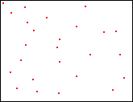
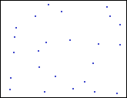
Error Masks
The whole memory space
Cells stuck-at-0
Cells stuck-at-1
M₀: Mask of stuck-at-0 cells
M₁: Mask of stuck-at-1 cells
Post-fabrication test to extract
M₀ and M₁
M₀
M₁

Slide 14
Outline
Background
Observation
Design Overview
Design Details
Error Masks
Error-bearing Training
Securing Error Masks at Client Side
Experiment Setup
Results

Slide 15

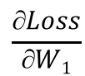
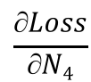
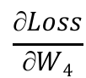
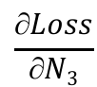
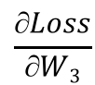
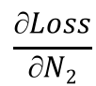
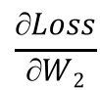
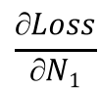
Conventional Training
W₁
W₂
W₃
W₄
I
N₁
N₂
N₃
N₄
Loss(T, N₄)
$$\frac{∂Loss}{∂N1}$$
$$\frac{∂Loss}{∂N2}$$
$$\frac{∂Loss}{∂N3}$$
$$\frac{∂Loss}{∂N4}$$
$$\frac{∂Loss}{∂W1}$$
$$\frac{∂Loss}{∂W2}$$
$$\frac{∂Loss}{∂W3}$$
$$\frac{∂Loss}{∂W4}$$

Slide 16
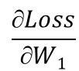
Error-bearing Training
F(W) = W & M₀ | M₁
W₁
W₂
W₃
F(W₁)
F(W₂)
F(W₃)
W₄
F(W₄)
I
N₁
N₂
N₃
N₄
Loss(T, N₄)
$$\frac{∂Loss}{∂N1}$$
$$\frac{∂Loss}{∂N2}$$
$$\frac{∂Loss}{∂N3}$$
$$\frac{∂Loss}{∂N4}$$
Apply batch normalization
after each convolution and
fully connected layer
$$\frac{∂Loss}{∂W1}$$
$$\frac{∂Loss}{∂W2}$$
$$\frac{∂Loss}{∂W3}$$
$$\frac{∂Loss}{∂W4}$$

Slide 17
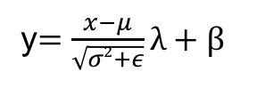
Batch Normalization
When the error bits occurs in higher significant bits (integer bits), the resulted error may impact too much
Batch normalization ( ) forces the activations to have zero mean and unit variance
All parameters in batch normalization is fixed during inference, small computation overhead
y$=\frac{x−μ}{\sqrt{σ2+ε}}λ+β$

Slide 18
Neural Network Protection
Server
Target
M₀:
1
1
1
1
…
0
1
W:
0
0
1
0
…
1
1
W
M₁:
0
1
0
0
…
0
0
M₀:
1
1
1
1
…
0
1
M₁:
…
F(W) = W & M₀ | M₁
0
1
0
0
0
0
F(W):
0
1
1
0
…
0
1
W
Pirate
M’₀:
1
1
0
1
…
1
1
Only F(W) can produce
satisfactory predictions
M’₁:
1
0
0
0
…
0
0
F’(W) = W & M’₀ | M’₁

Slide 19
Outline
Background
Observation
Design Overview
Design Details
Error Masks
Error-bearing Training
Securing Error Masks at Client Side
Experiment Setup
Results

Slide 20
Securing Error Mask At Client Side
Disable the read path of DRAM before release to user
Dynamic error mask selection
Small area overhead (mask 4 bits, group table 6 Bytes)
Since memory access pattern is determined for NN, the lookup is not on critical path
tRAS – 1ns
tRAS – 0ns
tRAS – 2ns
tRAS – 2ns

Slide 21
Outline
Background
Observation
Design Overview
Design Details
Experiment Setup
Results

Slide 22
Experiment Setup
We use Theano to explore error tolerance of different NNs
We developed a simulator based on DianNao accelerator for performance evaluation
We use 16-bit fixed point (1 sign bit, 1 integer bit, 14 fraction bits)
Schemes:
Baseline: DianNao accelerator design, use conservative DRAM timing parameters
AL: Adaptive Latency DRAM, reduce DRAM timing parameters but no errors
AEP: our design, reduce tRAS aggressively to introduce errors in weights
Benchmarks:

Slide 23
Outline
Background
Observation
Design Overview
Design Details
Experiment Setup
Results

Slide 24
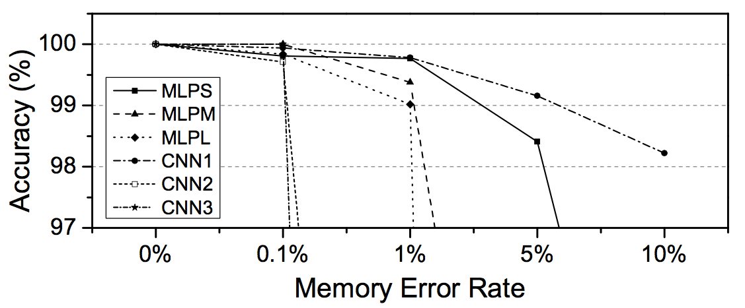
Error Tolerance
Different network has different error tolerance
We set the threshold to 1% accuracy loss (0.1% - 5% error rate)
Some applications do always prefer very high accuracy
Trade off between response time, energy and accuracy

Slide 25
IP Protection Effectiveness
Target Device: Do inference on the target device with the same error mask as used in training
Pirate Device: Do inference on a pirate device with a difference error mask as used in training
Error-Free Device: Do inference on a device without introducing errors
 | Target Device | Pirate Device | Error-Free Device
MLPS | 99.77% | 39.35% | 81.5%
MLPM | 99.38% | 28.31% | 71.43%
MLPL | 99.02% | 10.41% | 24.53%
CNN1 | 99.16% | 10.15% | 21.66%
CNN2 | 99.71% | 89.94% | 97.6%
CNN3 | 100% | 60.95% | 97.77%

Slide 26
Performance
The large improvement comes from the aggressively reduced tRAS in DRAM read.
NNs exhibit extreme memory access intensity
72% improvement over Baseline, 32% improvement over AL

Slide 27
Energy
AL reduces tRCD, tRAS, tWR and tRP, saves 24% energy over Baseline
Although AEP only reduces tRAS (more aggressively than AL), inference requires more reads than writes, energy save is larger (44% over Baseline)

Slide 28
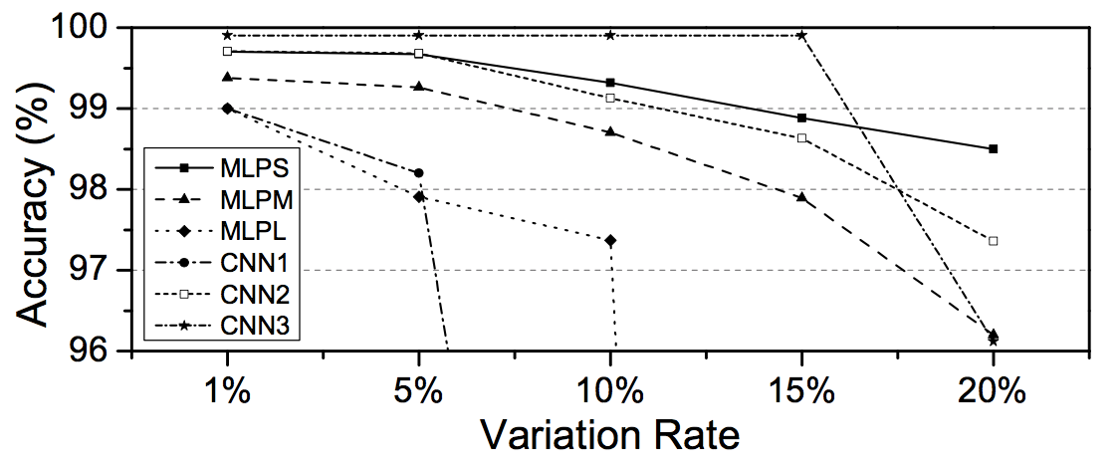
Robustness
VRT (Variable Retention Time) and chip voltage fluctuation can cause variations in error masks
VRT variation is in the order of 10⁻⁶
NNs can tolerate 1% to 15% difference in error mask

Slide 29
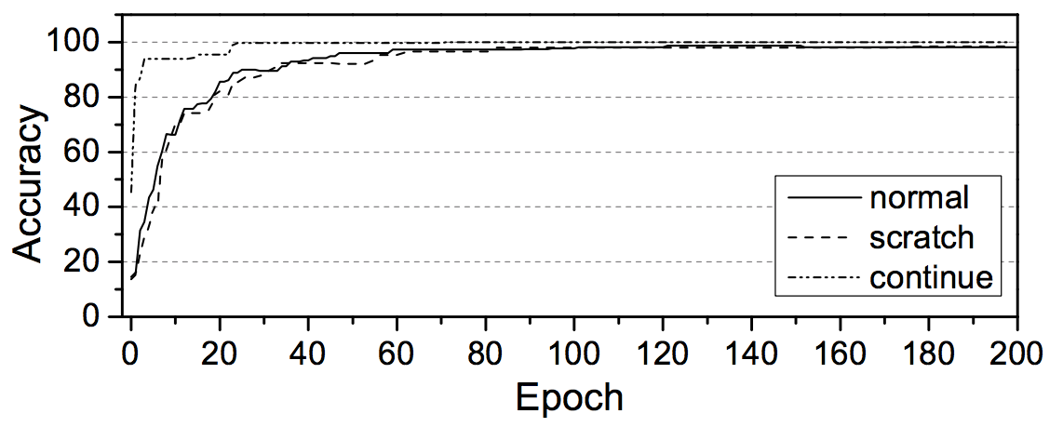
Training Time
Problem
Each device needs to be trained separately due to their unique error masks
Solution
First train the NN without error mask to get W_{no-error}
Continue training on top of W_{no-error} with each device’s dependent error mask applied separately

Slide 30
Conclusion
Problem addressed
Protect Neural Network in an energy and performance efficient way
Proposed solution
Use DRAM error mask as device’s fingerprint to prevent being deployed on pirate devices
We disable the DRAM read path and use a dynamic error mask selection scheme to protect error mask on client side
Results
Neural Network can be effectively protected
Achieve 72% and 44% improvement in performance and energy

Slide 31
Thank you

